Slide 1
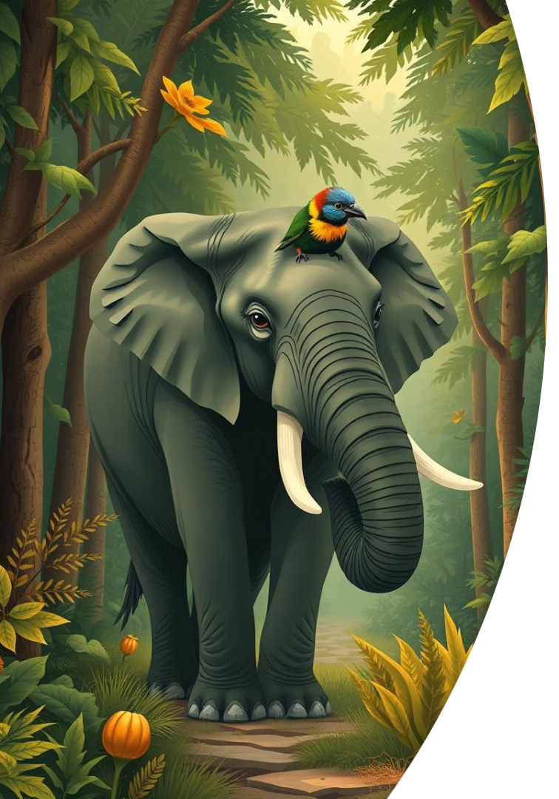



The Elephant and the Tragopan: A Poetic Encounter
An excerpt from Vikram Seth's renowned fable. Exploring nature's wisdom through unique characters. For Grade 8 English Literature students.
by Praveena Ramesh

Slide 2
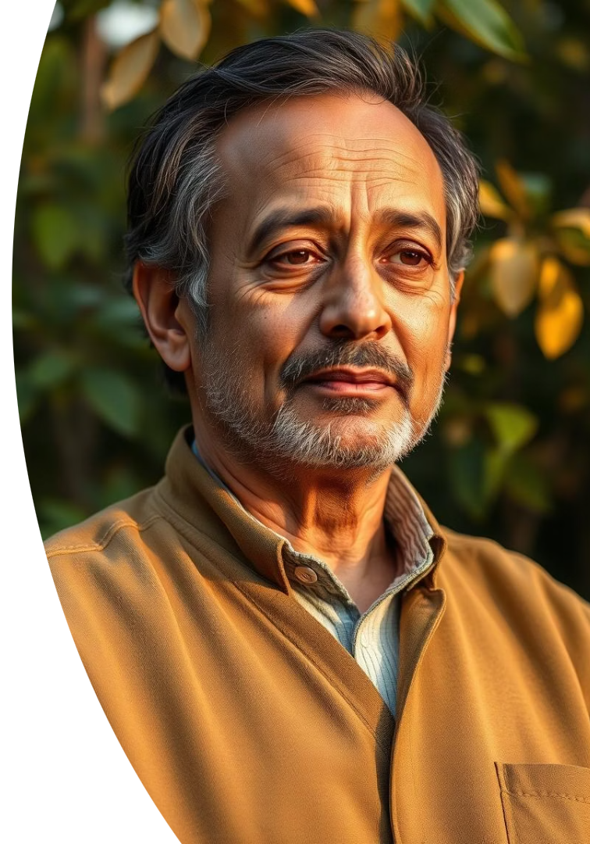



Meet the Poet: Vikram Seth
Celebrated Author
Versatile Forms
Nature Themes
Master of poetry, prose, and travelogues.
Explores harmony, coexistence, and nature.
Known for "A Suitable Boy," one of longest English novels ever.
Vikram Seth is a celebrated Indian novelist and poet, born in Calcutta (Kolkata). He is a Padma Shri and Sahitya Akademi Award winner.

Slide 3

Introduction to the Fable
Moral Fable
"The Elephant and the Tragopan" is a moral fable in verse.
Chance Encounter
Explores a chance encounter between two distinct creatures.
Himalayan Setting
Set in the majestic, biodiverse Himalayan foothills.
The poem highlights respect for varied perspectives and size, making it a timeless tale.

Slide 4
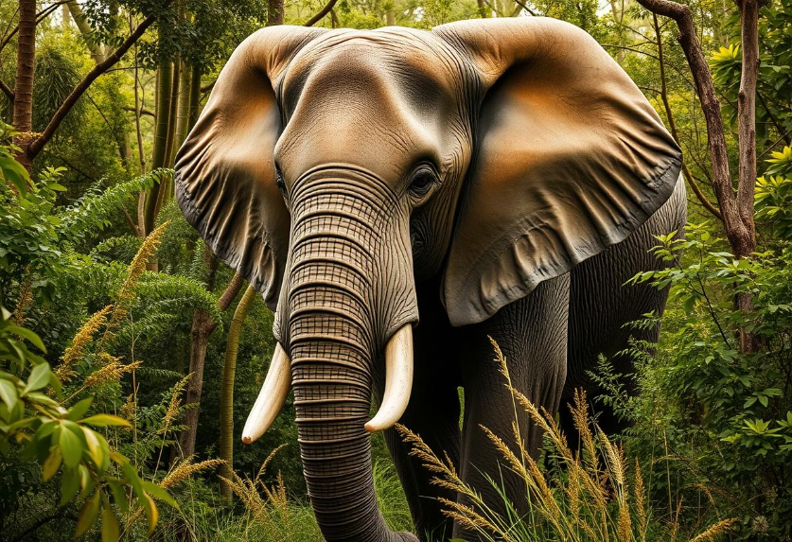
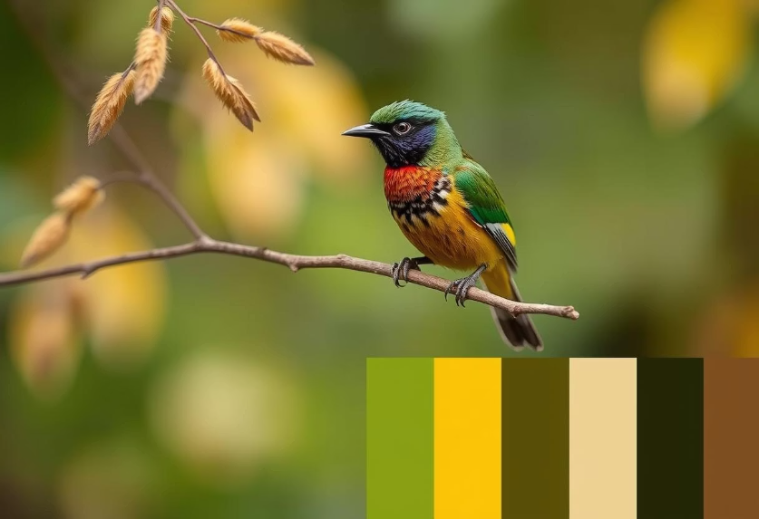
The Characters: A Study in Contrast
The Elephant
The Tragopan
Large, powerful, sometimes depicted as clumsy or overbearing.
Small, beautiful Himalayan pheasant, agile and wise.
Their interaction symbolises the relationship between might and wisdom. It portrays how different species can coexist or clash.

Slide 5

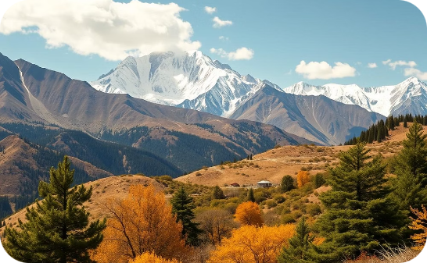
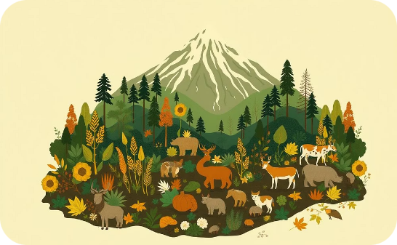
Setting the Scene: The Himalayan Habitat
Lush Forests
High Altitudes
Nature's Balance
The poem vividly describes lush forests and high altitudes.
Depicts rich biodiversity of the Himalayan region.
Emphasises nature's vastness and intricate balance. Tragopan often found at elevations 2,400-4,300 meters.

Slide 6
In Bingle Valley, broad and green
The tragopan last week had heard
Where neither hut nor field is seen,
The rumour from another bird
Where bamboo, like a distant lawn.
Most probably a quail or sparrow:
Is gold at dusk and flushed at dawn.
Such birds have gossip in their marrow-
Where rhododendron forests crown
That man had hatched a crazy scheme
The hills, and wander halfway down
To mar³ their land and dam4 their stream,
In scarlet blossom, where each year
To flood the earth on which they stood,
A dozen shy black bears appear,
And cut the woods down for their wood.
Where a cold river, filmed with ice.
The tragopan, good-natured pheasant,
Sustains a minor paradise,
A trifle shocked by this unpleasant
An elephant and tragopan
Even if quite unlikely news
Discussed their fellow creature, man.
Had scurried off to test the views
Of his urbane and patient friend,

Slide 7
The elephant, who in the end
And if you have a bamboo shoot
Had swung his trunk from side to side
Or fresh oak-leaves, or ginseng-root
With gravitas, and thus replied:
Something that's crunchy but not prickly...
"Who told you? Ah, the quail-oh well,
I feel like biting something quickly."
I rather doubt-but who can tell?
The elephant prepared the tea
I would suggest we wait and see.
In silence, then said carefully:
Now would you care to have some tea?"
"Now let me think what I can get you.
"Gnau! Gnau!" the tragopan agreed.
I fear this rumour has upset you.
"That is exactly what I need.
Your breast looks redder than before.
Do ruffle down. Here, let me pour."
He drew a lukewarm gallon up
His trunk, and poured his friend a cup

Slide 8

Excerpt: Setting the Scene
In Bingle Valley, broad and green, Where neither hut nor field is seen, Where bamboo, like a distant lawn, Is gold at dusk and flushed at dawn, Where rhododendron forests crown The hills, and wander halfway down In scarlet blossom, where each year A dozen shy black bears appear, Where a cold river, filmed with ice. Sustains a minor paradise, An elephant and tragopan Discussed their fellow creature, man.
The poem begins by painting a picture of a pristine, untouched valley in the Himalayas.

Slide 9
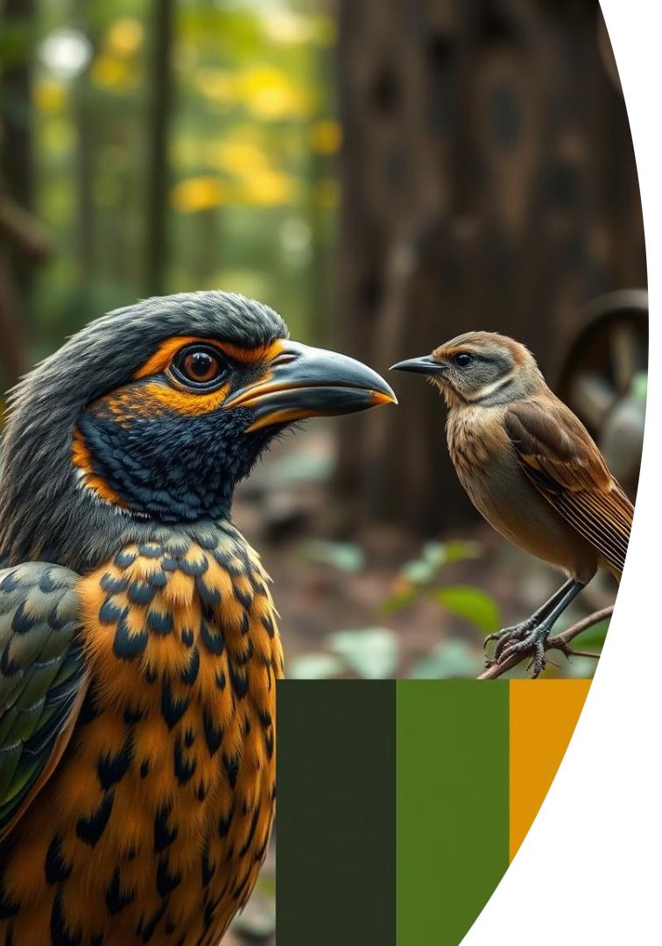




The Rumour Spreads
Tragopan Hears Rumour
From another bird, likely a quail or sparrow.
Man's Crazy Scheme
To mar land and dam stream, flood earth, cut woods.
Tragopan's Shock
A trifle shocked by this unpleasant, unlikely news.
Seeks Friend's Views
Scurried off to test the views of his urbane and patient friend.
The tragopan, good-natured pheasant, is deeply troubled by the news of human interference.

Slide 10



The Elephant's Reply
Wait and See
1
Suggests a patient approach to the rumours.
Scepticism
2
Doubts the quail's gossip but remains open.
Gravitas
3
Replies with wisdom and calm composure.
The elephant responds with calm wisdom, advocating patience and a "wait and see" approach. The tragopan agrees.

Slide 11
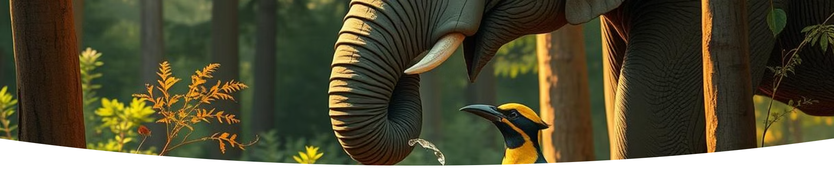
Tea and Comfort
Tragopan's Request
Elephant's Care
Warm Tea
Wants something crunchy: bamboo shoot, oak-leaves, or ginseng-root.
Observes tragopan's upset, offers comfort and tea.
Pours a lukewarm gallon from his trunk for his friend.
The elephant thoughtfully prepares tea and offers comforting words to the visibly distressed tragopan.

Slide 12
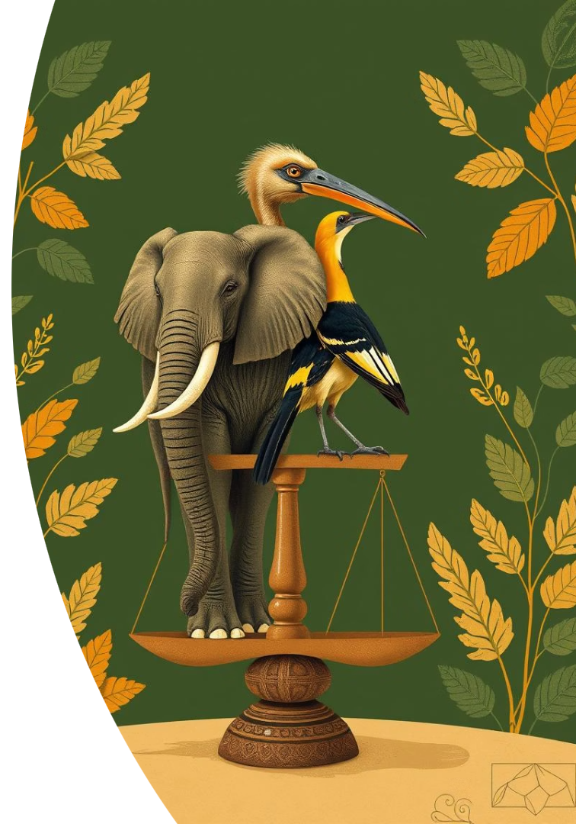
Themes Explored in the Excerpt
Coexistence
How disparate beings can share a space.
Humility vs. Arrogance
Lessons for the powerful from the meek.
Environmental Respect
Importance of valuing all life forms.
Wisdom over Strength
Brains often triumph over brawn.
Vikram Seth's poem subtly conveys profound messages about nature, power, and mutual respect.

